Slide 1



SUBJECT ON A PAGE
Design Technology
INTENT
Church Gresley Infant and Nursery School’s Design Technology curriculum intends to supports our pupils in all elements of our school core values ‘Independence, Resilience, Kindness, Respect and Honesty’ through the cycle of design, make and evaluation. Fun activities will inspire pupils to develop new skills including research, modelling, testing, making and reflection. Our Kapow scheme units of work allow pupils to acquire the appropriate subject knowledge, skills and understanding as set out in the Early years foundation stage (EYFS) statutory framework and the National Curriculum for Key Stage 1. Activities will highlight the importance of Design Technology in the wider world and how skills can contribute to our communities and their future ambitions. We intend Design Technology to prepare our children, to give them the opportunities, responsibilities, and experiences they need to be successful as they progress to the next stage of their education and as a foundation to life in the 21st century.
IMPLEMENTATION
Church Gresley Infant School’s Design Technology Long Term Plan ensures Kapow units planned to build on skills and ensure progression. During Key Stage 1, Church Gresley Infant School’s Design Technology planning outlines the three main stages of the National Curriculum design process: design, make and evaluate. Our Design Technology projects have a clear progression of skills and knowledge for each year group which is implemented through five strands:
1. Design
2. Make
3. Evaluate
4. Technical Knowledge
5. Cooking and Nutrition
Our carefully selected projects ensure children will build on previous learning. Key skills are revisited and built upon with added challenge and complexity. Well planned and resourced projects provide children with fun, practical experiences. Teachers take ownership and plan flexibly for Design Technology; making cross curricular links and often teaching Design Technology as a block of lessons to allow the time needed for the children to be critical, inventive and reflective on their work. Each project implements the principles of designing, making, evaluating and incorporates the technical knowledge and understanding in relevant contexts. Our progression document also includes Key Stage 2 projects and expectations, in order to ensure children have the skills and knowledge ready to move their learning forward.

Slide 2





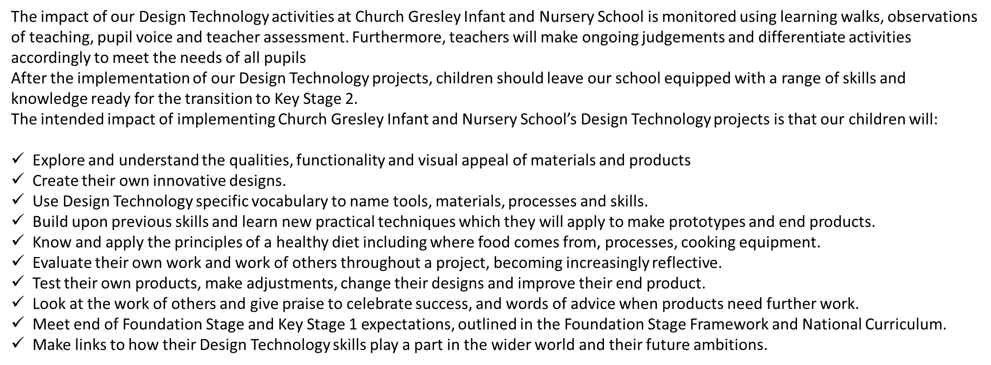
Design Technology in the EYFS
The Long Term Plan document for teachers begins in the Early years foundation stage. During the EYFS pupils explore and use a variety of media and materials through a combination of child initiated and adult directed activities. They have the opportunities to explore a variety of media and materials and to express their own ideas. Children then apply what they have learnt about media and materials in original ways, thinking about form, function and purpose. Children have opportunities to make plans and construct with a purpose in mind using a variety of resources, adapting their work along the way. Teachers use Kapow units of work and the knowledge of our children to plan for Design Technology related activities across all areas of learning and make links to real life contexts. Children are encouraged to develop the skills to use simple tools and techniques appropriately, effectively and safely. Children develop essential basic skills in Design Technology which prepares them for their transition into Year 1
SEND
EEF ‘5-A-DAY APPROACH’ IN DT
Our DT scheme is designed to be fully adaptable for SEND pupils. Every lesson plan includes suggestions for adaptive teaching, providing clear guidance on how activities can be modified to meet the needs of all learners.
Children learn in a variety of ways. As such, our DT lessons include a range of strategies to support and challenge every pupil, incorporating the EEF ‘5 a Day’ approach.
Embedding adaptive teaching and the ‘5 a day’ throughout, our D&T scheme ensures that all pupils, regardless of their starting points, can access and succeed in their D&T projects.
In addition, our step-by-step curriculum design supports pupils with SEND, avoiding sudden jumps in complexity at transition points and allowing for steady, manageable progression.
EXPLICIT INSTRUCTION
  Clear design and make instructions, and structured DT tasks – ensuring clarity and reducing cognitive load for pupils who benefit from additional support.
  COGNITIVE AND METACOGNITIVE STRATEGIES
  Lessons incorporate different elements to engage all learners including ,multi-sensory approaches.
SCAFFOLDING
DT projects are designed with flexibility in mind, allowing for additional support or challenge where needed.,
  TECHNOLOGY
Digital tools can support areas of difficulty.. Taking photos to record designs or video to verbalise ideas and reviews. Using an iPad to create a simple labelled design rather than pencil and paper. Watching videos that demonstrate mechanisms and repeat instructions. Using child-friendly apps to prototype (e.g., drawing tools).
FLEXIBLE GROUPING
Opportunities for collaborative and independent learning – allowing pupils to work on their DT products at their own pace while building confidence and independence.
IMPACT

