Slide 1
Welcome to Reception
Wednesday 16th September 2026

Slide 2
Early Days
Well done to all the children who have settled well during their first weeks at school.
Appreciate it is a big step for children and parents/carers.
Please speak to your child’s class teacher if you have any concerns.
Please rest assured if your child comes in upset, they soon settle, if not staff will call home.

Slide 3
Teachers and TA’s in Reception
Outstanding Owls: Teacher: Miss Dixon
Teaching Assistant: Mrs Duffy
Kind Koalas: Teacher: Mrs Ridgard (Monday to Thursday) and Mrs Elks (Wednesday am and Friday all day)
Teaching Assistant: Mrs Fairbairn
Gentle Giraffes: Teachers: Mrs Attenborough
Teaching Assistant: Mrs Harris

Slide 4
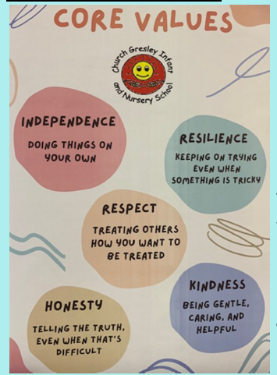
In reception we give out house points which will
be awarded for our Core Values.
When children receive a house point, they will be told which core value it is for and why.
A core values certificate will be awarded each week in Friday assembly.

Slide 5


A reminder on our approach to behaviour…
Rolling system rather than weekly.
Children move up the rainbow for a good day in school or for extra special work/behaviour/
following the core values.
Opportunity for more than one sunshine sticker in a week.
- Consequences directly linked to behaviour.
- Wellbeing Time on a Friday.

Slide 6
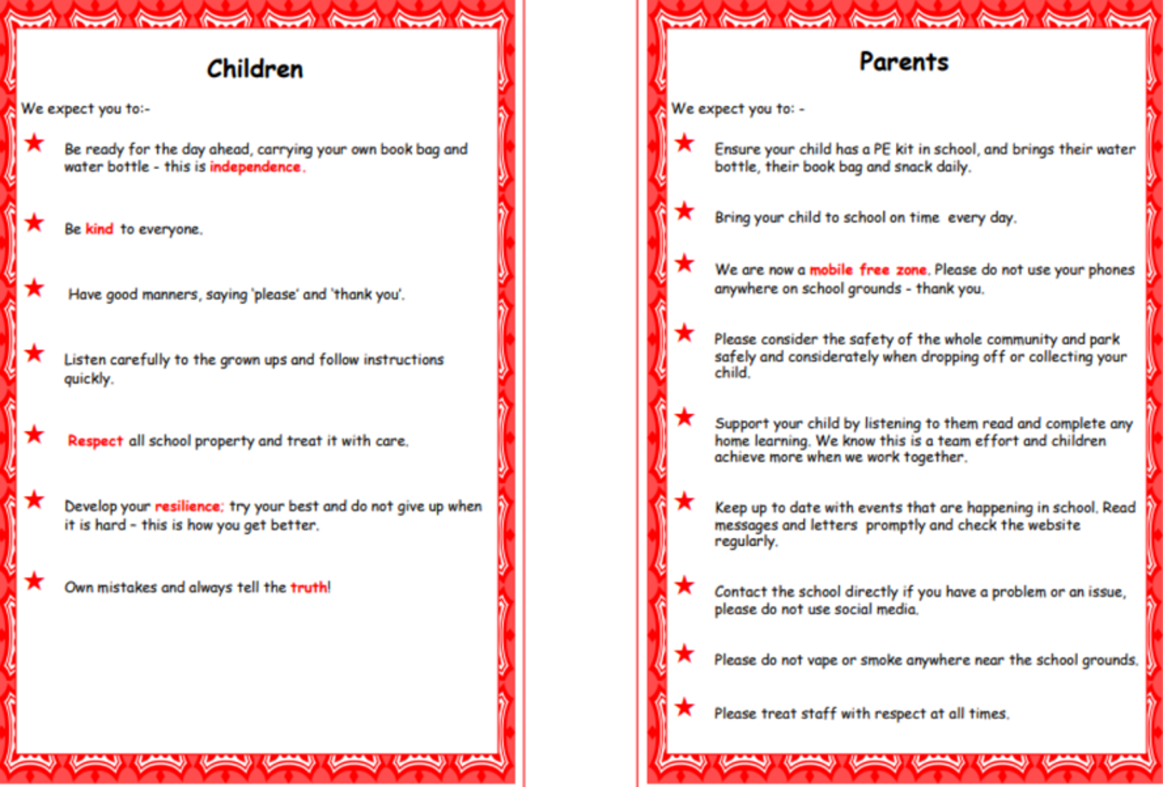
School Charter

Slide 7
Early Years Framework
Staff are busy ‘assessing children on RBA (please see more information on our website ‘RBA 2025’).
In Reception, we use our knowledge of child development, observations and interactions to understand each child's learning journey.
We use Development Matters to guide our teaching and support children as they work towards the Early Learning Goals, which are the expectations for children by the end of Reception.
You will be provided with more information early next year about the importance of ‘Early Learning Goals’.

Slide 8
Planning
We plan as a team.
This term our topic is called ‘Magical Me!’. This topic is an opportunity for us to get to know your child.
Each term a topic web can be found on our school website under the heading key information – school curriculum – reception.
I will also be sending out a termly newsletter to inform parents/carers of other important information.

Slide 9
Phonics
Phonics is taught daily.
We follow ‘Essential Letters and Sounds’ (ELS), this is a whole school scheme for phonics.
Mrs Woodward and myself will be holding a meeting on Wednesday 23rd September to explain more about how we teach phonics in school.
Your child will be sent home with a pack of initial sounds which we would like children to use at home to support their phonics knowledge.
Reading diaries will also be sent home for you to record how your child is progressing with their sounds. We appreciate a short comment.
Alongside the sound cards we will also be sending home ‘common exception words’, ‘I, no, go, to, the, into’.

Slide 10
Reading
Reading books will be sent home later in the term once we are confident your child is able to have a go at reading a book.
Children will receive a house point when they read at least three times a week. Certificates will be given to children who read every day.
We promote the ‘love of reading’, you will see this reflected in and around our classes.
We promote the ‘love of reading’ by reading a variety of books to the children and emerging them in a variety of topic books.
We ask kindly that you support us with children’s reading by taking the opportunity to read to them on a regular basis. Bedtime is a great time for this!
We will have weekly library slots. Days TBC
Local library is a great free resource!

Slide 11
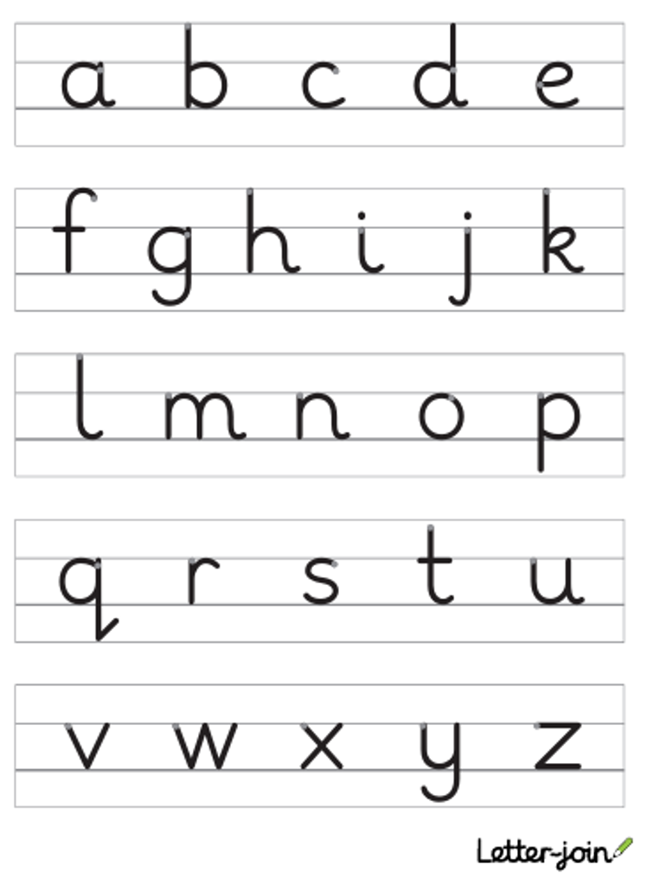
Handwriting
We spend lots of time in reception concentrating on fine motor skills (using tweezers, tracing patterns etc)
Work hard on developing a good pencil grip (tripod grip).
We follow ‘letterjoin’ to support children with skills in writing.

Slide 12
Outdoor Learning in Reception including Forest School
Please ensure your child has a suitable coat and footwear every day.
We aim to go out in all weathers!
Encourage children to be as independent as possible at putting their coat on and fastening it themselves.
If possible, we appreciate if your child can have a pair of wellies in school, allowing them to explore the muddy areas in all weathers.
Forest School Sessions:
Outstanding Owls: Thursday afternoon
Kind Koalas: Wednesday morning
Gentle Giraffes: Thursday morning

Slide 13
P.E
Outstanding Owls on Monday Morning
Kind Koalas on Thursday afternoon
Gentle Giraffes on Friday morning
Please ensure your child has their P.E kit in school daily and your child does not wear earrings on these days.

Slide 14
Seesaw
We use the Seesaw app in school as a form of communicating with children and parents/carers about homework or school messages. As a school we also use a SchoolApp – aware regarding class/year group WhatsApp groups please ensure if you are unsure about anything you contact school directly.
We will be using Seesaw as a form of a Learning Journey as your child moves through reception. More details will follow soon.
PLEASE DO NOT SHARE IMAGES FROM SEESAW on any other platform.

Slide 15
Snacks and Water Bottles
Water bottles – please ensure your child has a labelled water bottle in school. No juice please. We fill water bottles up during the school day.
IMPORTANT:
Please note that we are not a nut-free school. However, we have children with nut allergies and kindly ask families not to send nuts or nut-containing products into school. Thank you for your support in helping us minimise the risk to children with allergies.
• Apples, grapes, cherry tomatoes and large berries: quarter lengthways.
Please be aware there is a nutrition guidance which has been issued to all Early Years Settings from the DfE.
It is important we work together to ensure children have a well-balanced diet.
Further information can be found on our school website under ‘Guidance for new starters
Two snack sessions a day:
Morning: milk and fruit is provided
Afternoon: childrare invited to bring their own fruit into school.

Slide 16
Any questions?

Slide 17
Thank you for attending today.
Mrs Woods and the Reception Team

